Slide 1
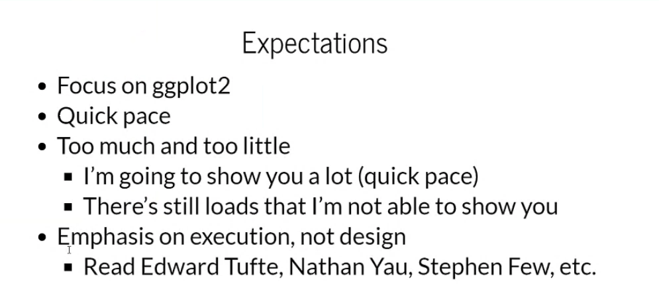

Slide 2
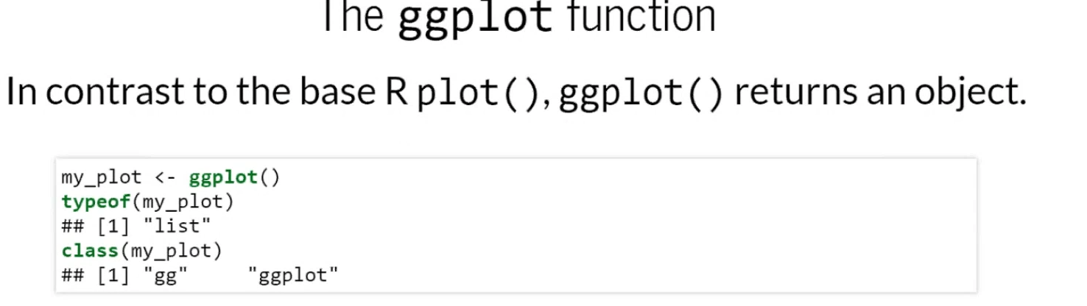
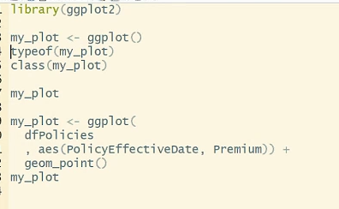

Notes:
Gg = grammar of graphics
Typeof() vs class()

Slide 3
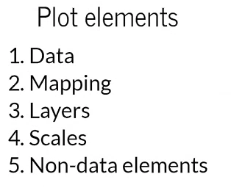
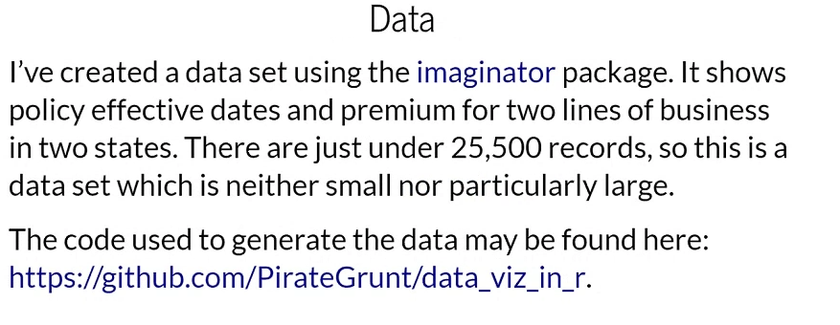
Notes:
Data maps to a visual element
Layer = visual object, where items show up
Scales define how the axes of the plot look, and the format of the labels
Non-data elements are things that appear on a plot that are not mapped to the data
Imaginator package = can simulate insurance policies and add things like (policy start/end dates)

Slide 4
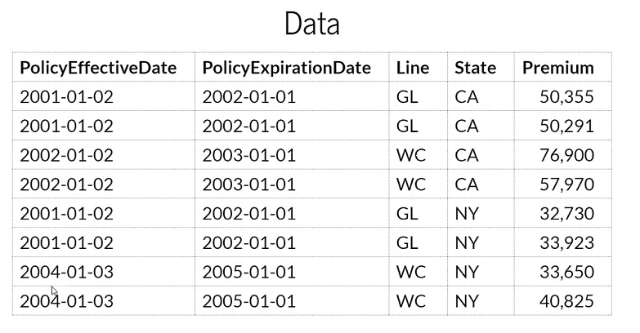
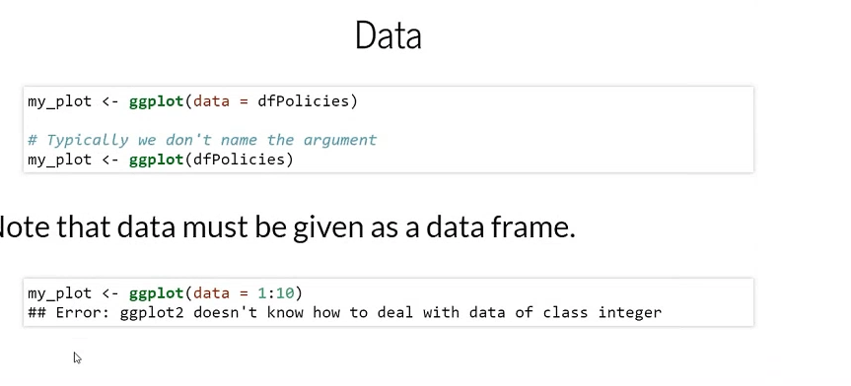
Notes:
Ggplot only accepts data frames as an argument

Slide 5
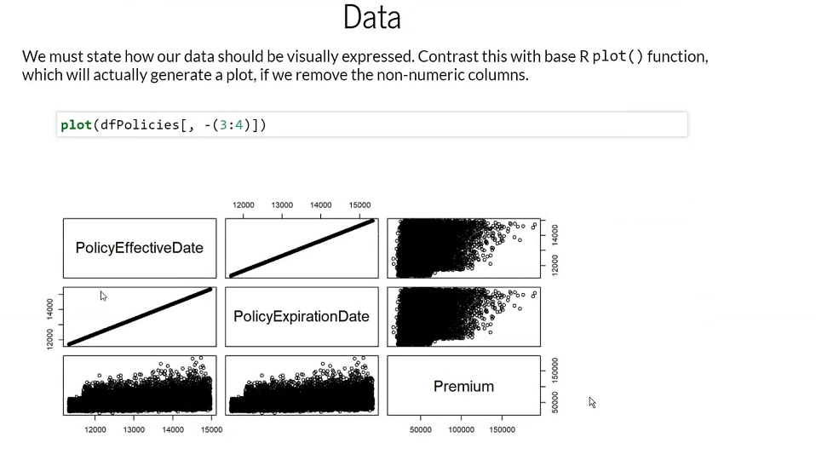

Slide 6
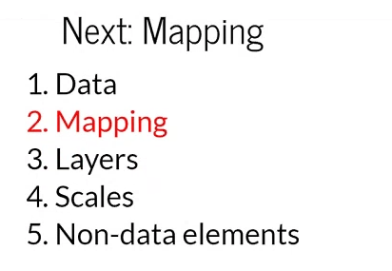
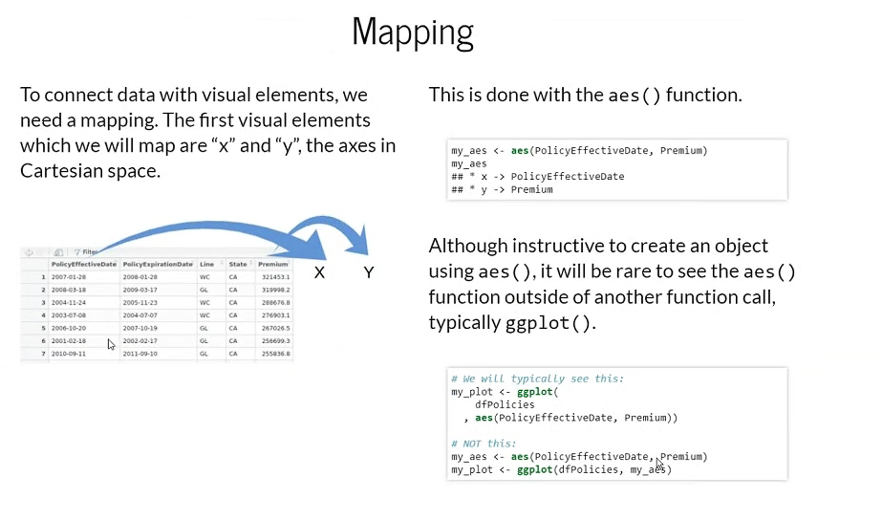
Notes:
We map a single column to a single visual element
Here we map X and Y (visual elements) that must map to data visual elements, and we do that with the aes() function (short for aesthetics).
Common to use aes() within ggplot()

Slide 7
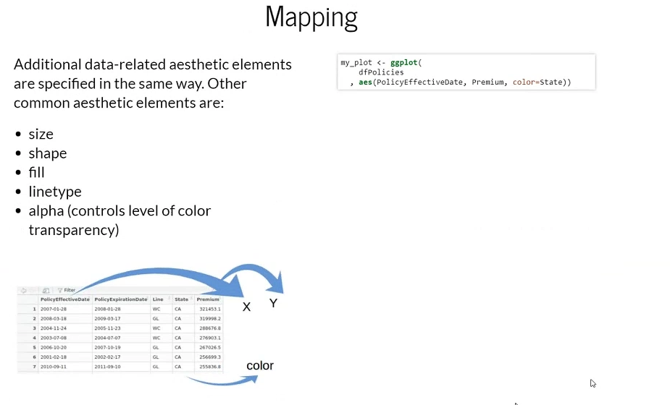

Slide 8
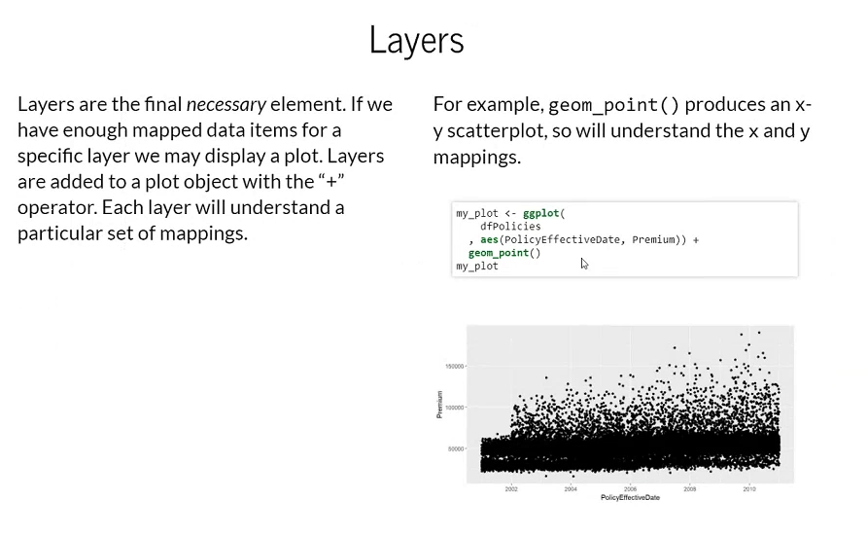
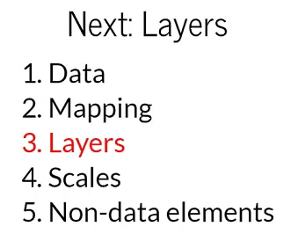
Notes:
Layers are added to the plot with a + sign
The + sign with gglot adds element

Slide 9
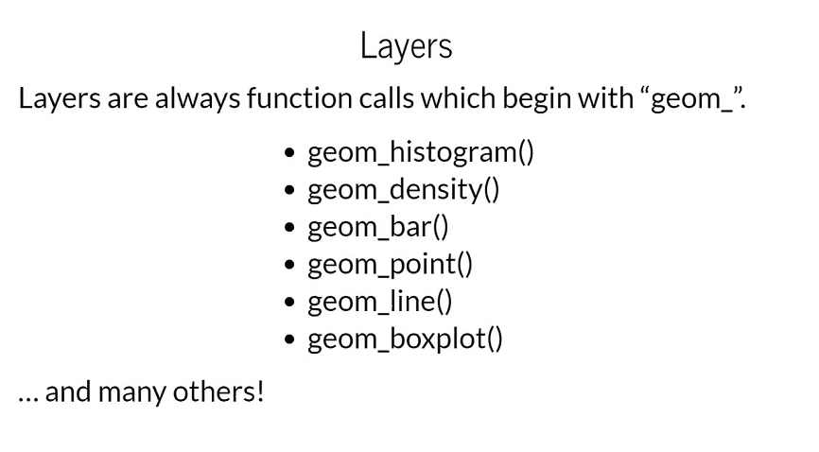
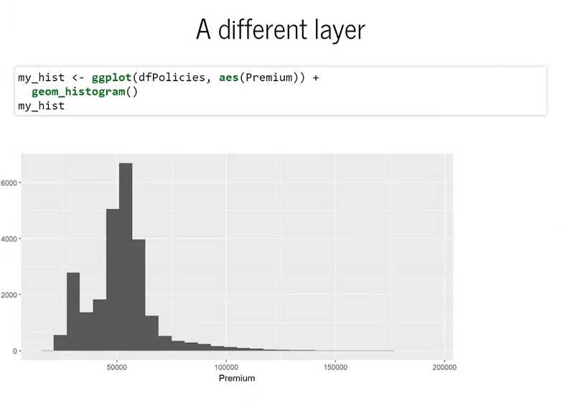
Notes:
Same data but using a different layer

Slide 10
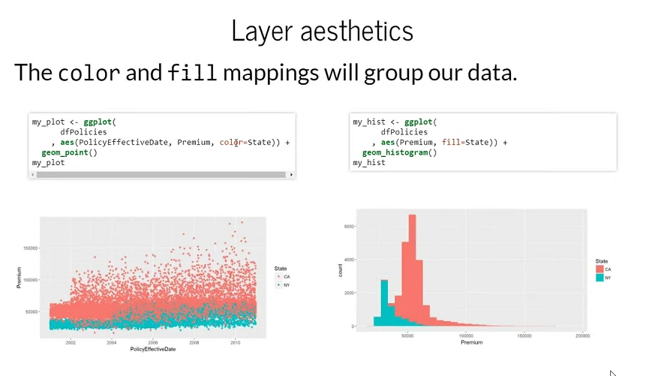
Notes:
Adding additional effects for color by State

Slide 11
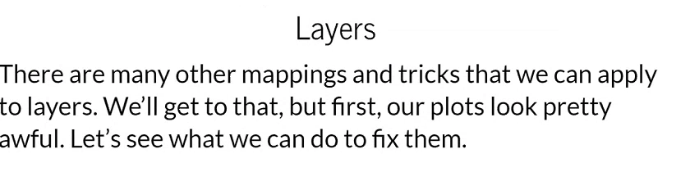
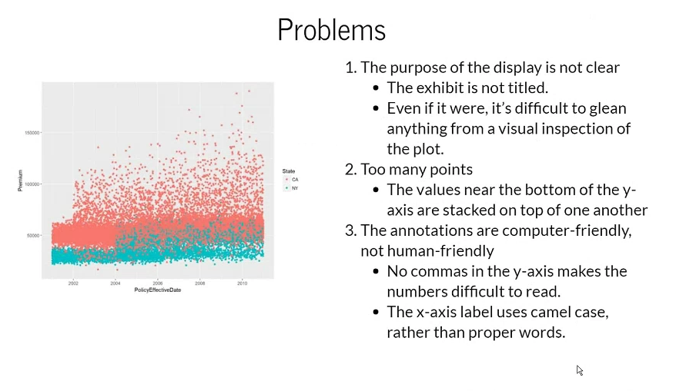
Notes:
Points on the bottom stack on top of each other so much they’re effectively solid
what else can we add to this graph to make it look nicer?

Slide 12
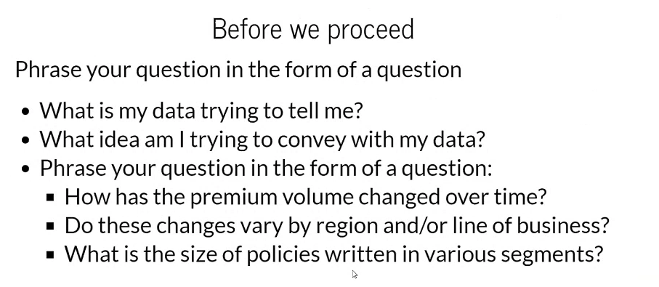
Notes:
Note the connection died for 3 minutes, lost content between this and next slide

Slide 13
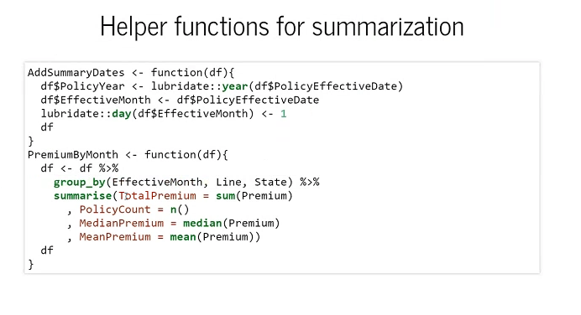

Slide 14
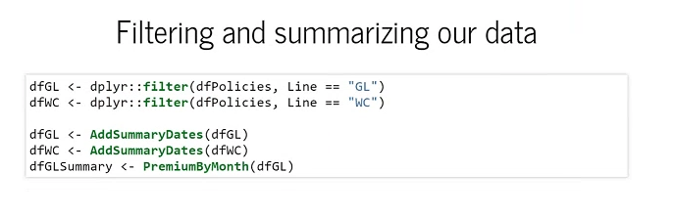
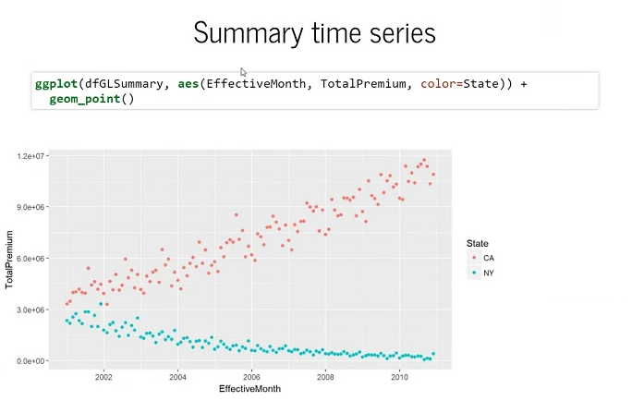
Notes:
Splitting two insurance lines (gen liab from workers comp)
When we use effective month rather than policy effective date for the x-axis, the graph makes a bit more sense. We can see premium for CA is going up over time, and reducing over time for NY.

Slide 15
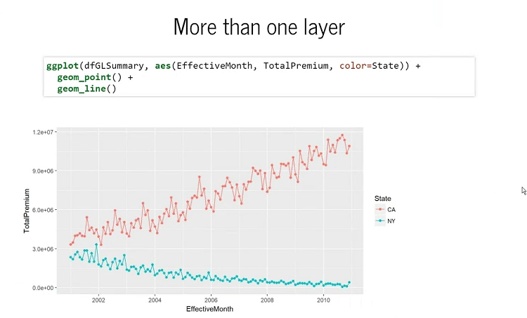

Slide 16
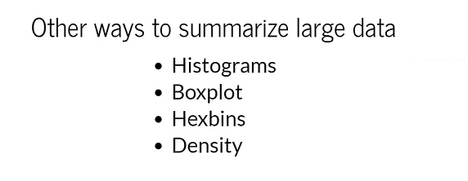

Slide 17
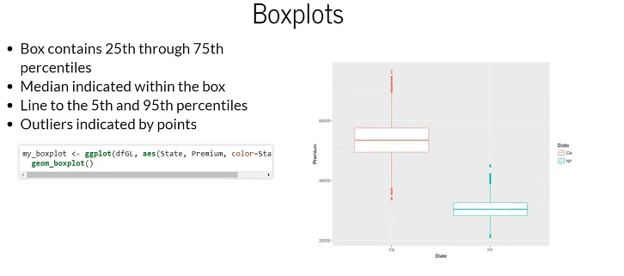

Slide 18
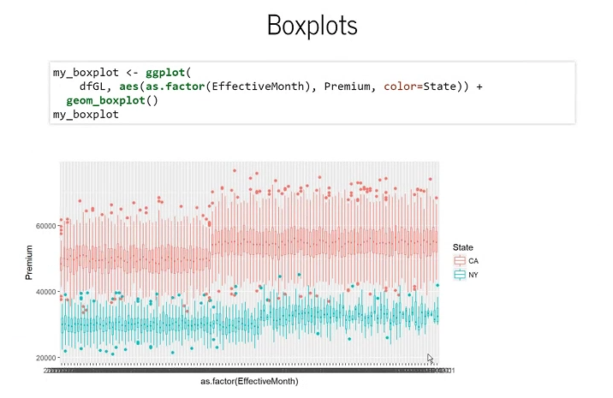
Notes:
Using boxplot with > 2 categories (here we are using effective month)
We have to transform it to a factor using as.factor() to get categories
We can recognize the shift in medians in CA in the middle (goes from 50k to 55k). Clearly something operational happened in this data. Most likely a rate change.

Slide 19
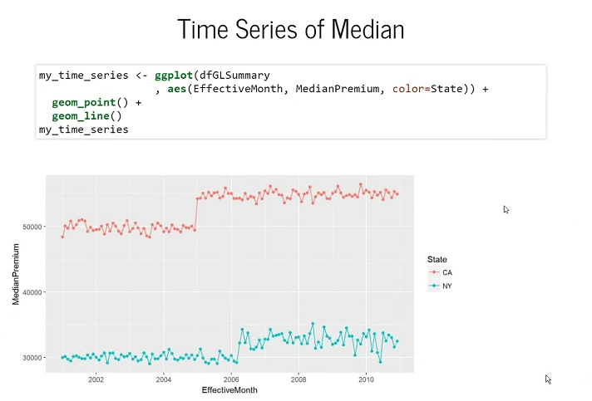
Notes:
Here we use the Summary data frame and only render the median on the y-axis
We should see similar information to the prior slide with the box plot. Again this is summarized data (only looking at medians)

Slide 20
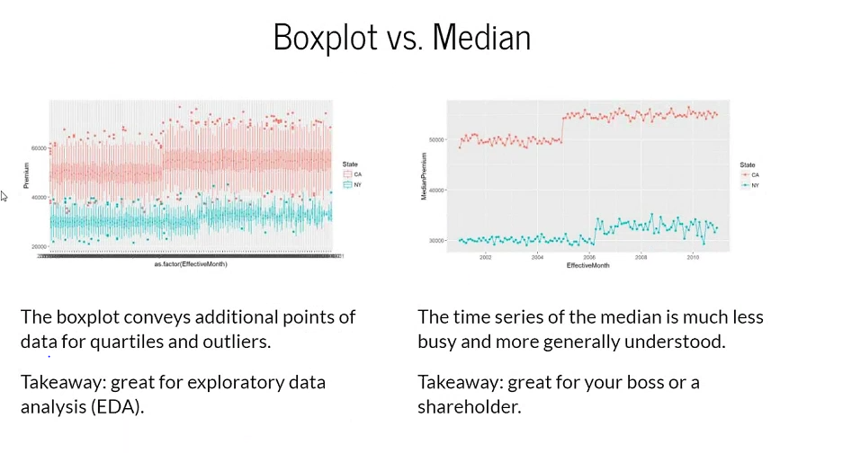
Notes:
So which would you use???
Boxplot gives you a sense of the range and outliers – but very busy! Good for exploratory data analysis
Time series of median is simpler and more clear. Good to emphasize something

Slide 21
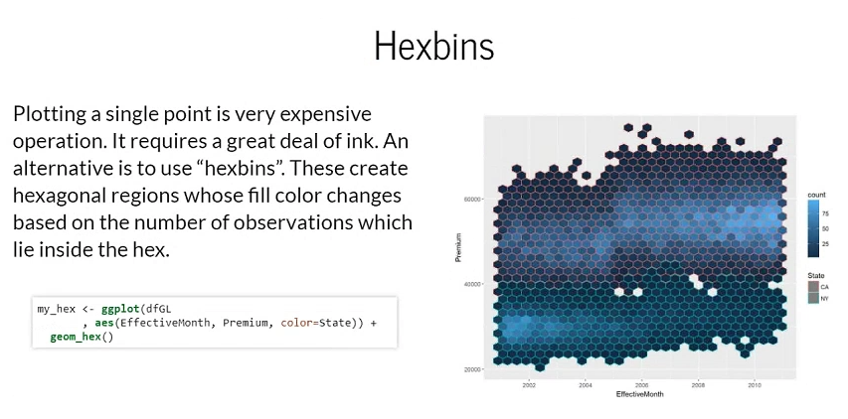
Notes:
Hexbins – shows hexagonal shapes where the shading depends on the number of observations within that hexagon-point
Here we use the GL non-summarized data frame (GL = general liability), and we use geom_hex() to ge a hexbin image
We can see volume for CA is going up and volume for NY is going down

Slide 22
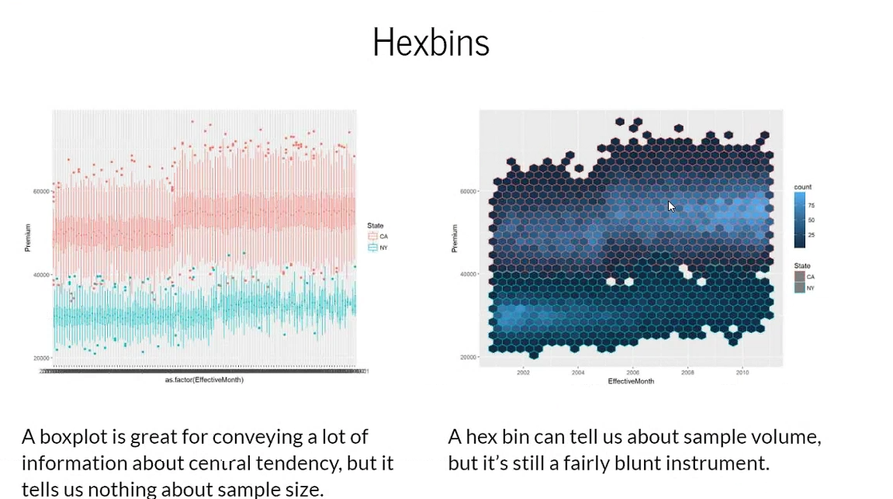
Notes:
Hexbin is useful if a scatter plot won’t work due to large sample size

Slide 23
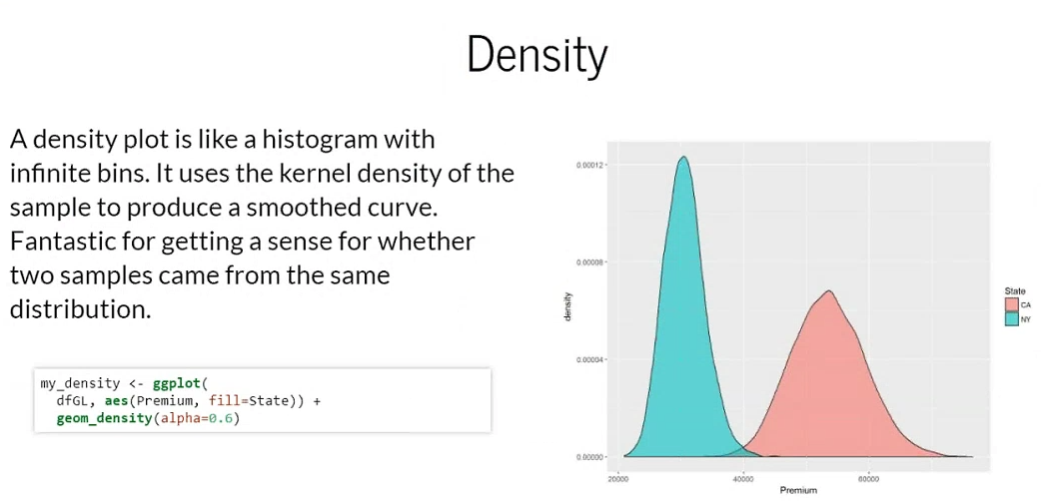
Notes:
Again using non-summarized GL data frame; we are interested in premium value using State to color the plots and give us two plots

Slide 24
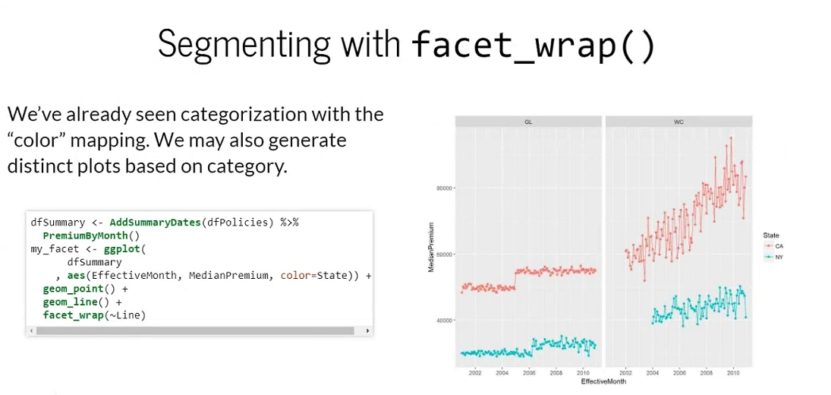
Notes:
Categorization can help you deal with a large sample volume
Can categorize visually by using facet_wrap(), it takes a plot and divides it into multiple facets
Here we are duplicating the time series of the GL data set, and we can use the ~ in facet_wrap to split the data into two groups. Here we split on the line (left = GL, right = WC)
You can see for WC, premium for CA is going way up, but for NY the slope is not as steep. This gives us a sense for the rate in which WC prem is increasing

Slide 25
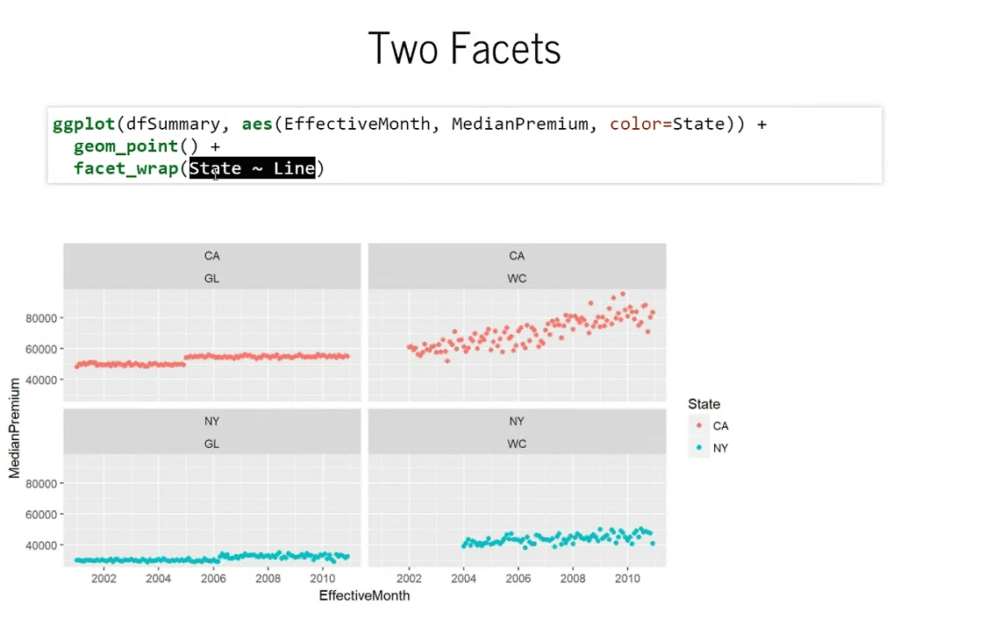
Notes:
Here we split first by state and then by insurance line of business

Slide 26
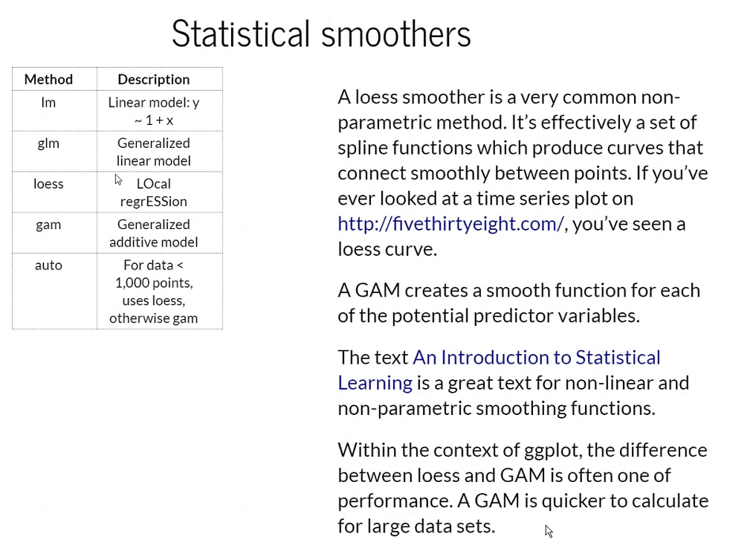
Notes:
Ggplot will allow you to use trend lines (similar to adding a trend line in Excel)
Does require some methods (column 1 above) to do this
LOESS is basically a moving average
Generalized Additive Model looks at all the potential predictor variables and creates a smoother function in such a way that you can add them together to get a predictive model

Slide 27
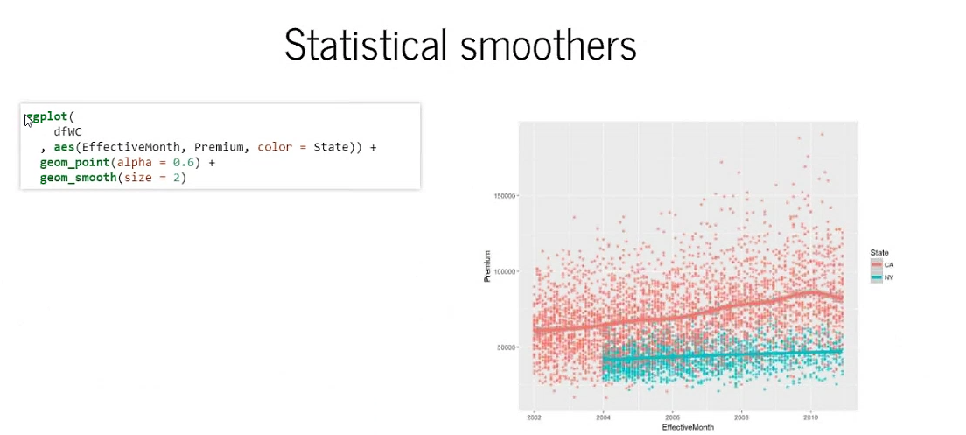
Notes:
To add a smoother, we use a point layer geom_smooth (loess)

Slide 28
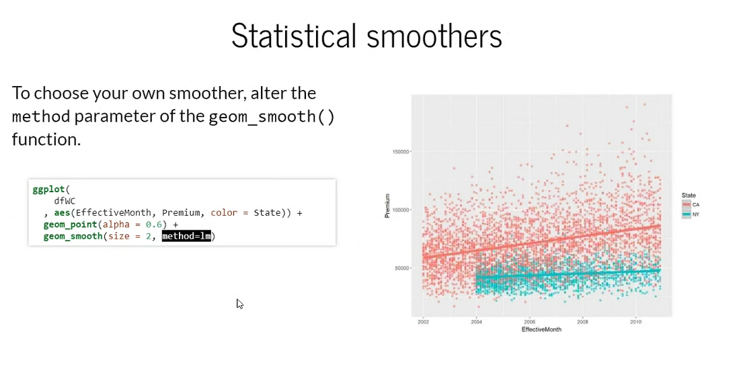
Notes:
What if we wanted a linear model? Use method=lm

Slide 29
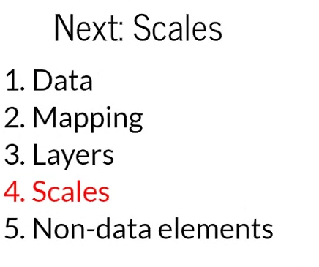
Notes:
Improve graphs further using scaling

Slide 30
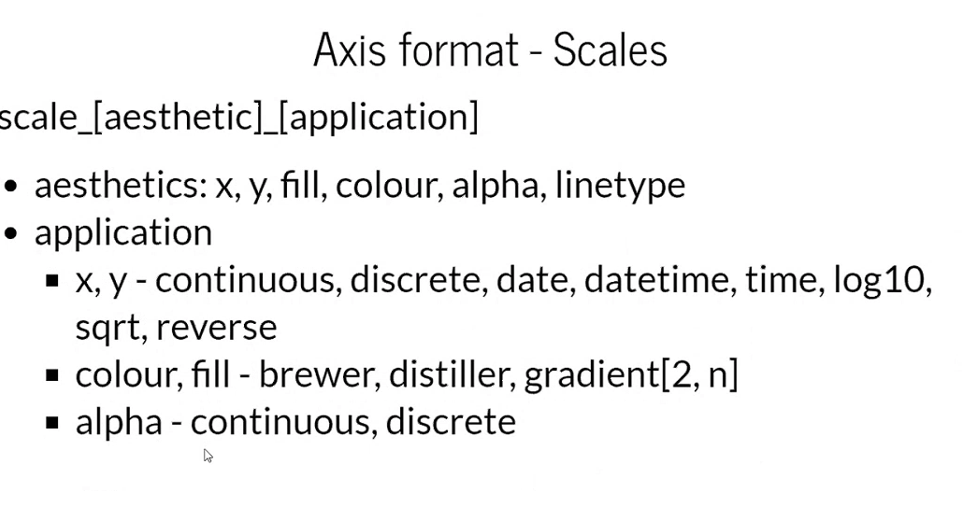
Notes:
Scale is the way to think about axes of graphs
Syntax is above: scale_[aesthetic]_[application]

Slide 31
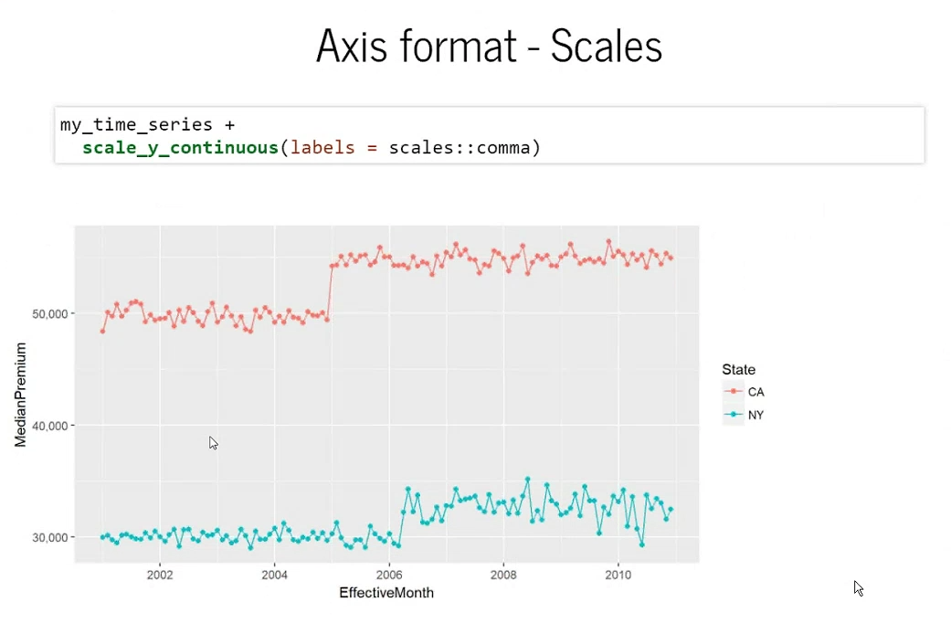
Notes:
We are adding scaling to the time series: scale_y_continuous, y = aesthetic, and continuous = application
We use the comma function from the scales package (this adds commads)
We don’t know the currency and do we need the 0 zeros?

Slide 32
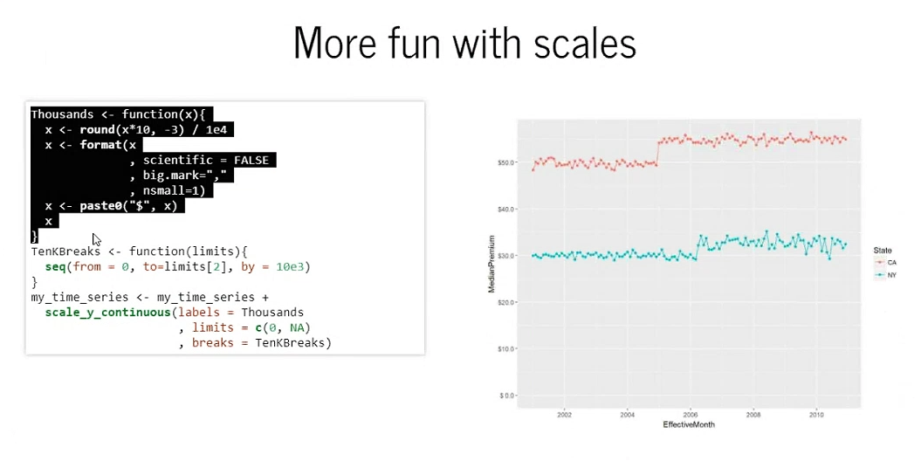
Notes:
Thousands is a function that translates the thousands of dollars to be in units of thousands, and then we add the comma
TenKBreaks is a function that returns a vector that supply to create the

Slide 33
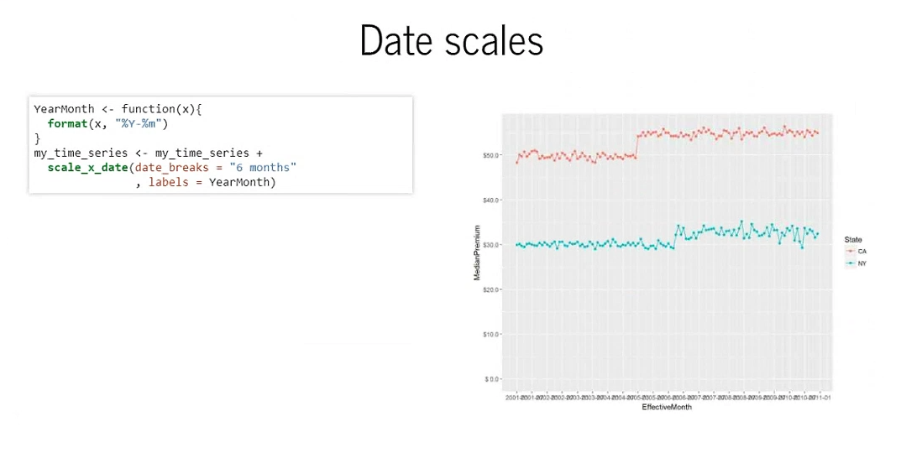
Notes:
We can use scale_x_date function, date is the application and we apply it to the x-axis aesthetic.
This splits the x-axis into units of 6 months and then we change the format to YearMonth (hard to tell because all labels are on top of each other)

Slide 34
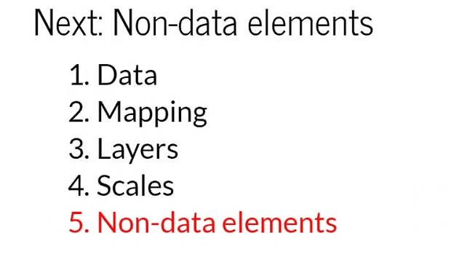
Notes:
Important elements visually but don’t have a mapping

Slide 35
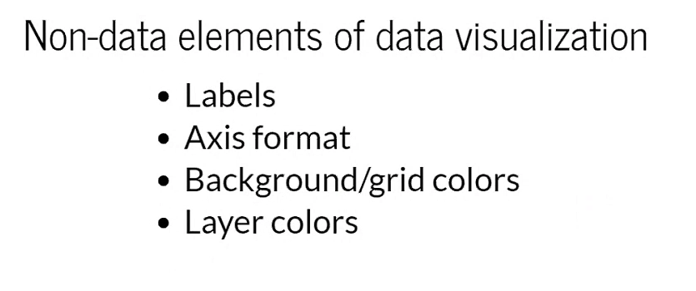

Slide 36
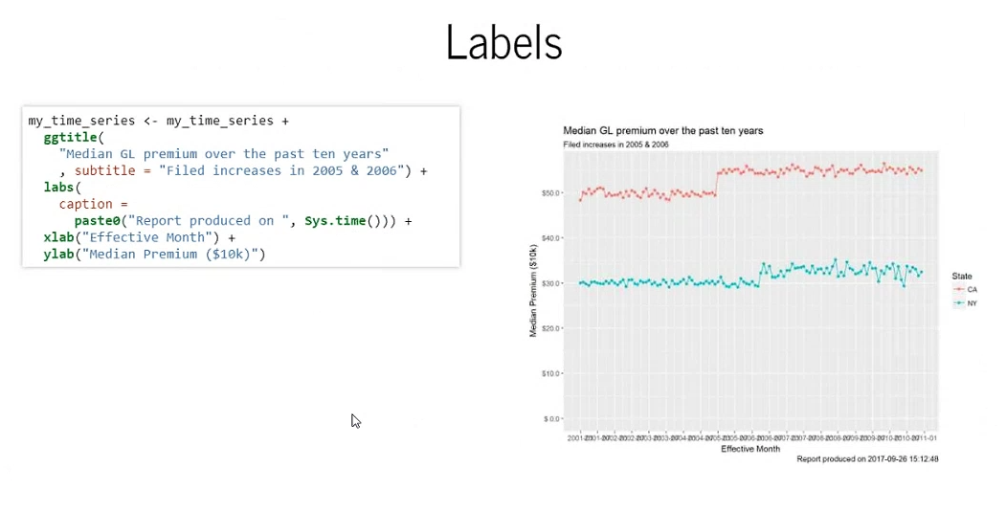
Notes:
Ggtitle adds a title
Labs() can add a footer to the plot (lower-right)

Slide 37
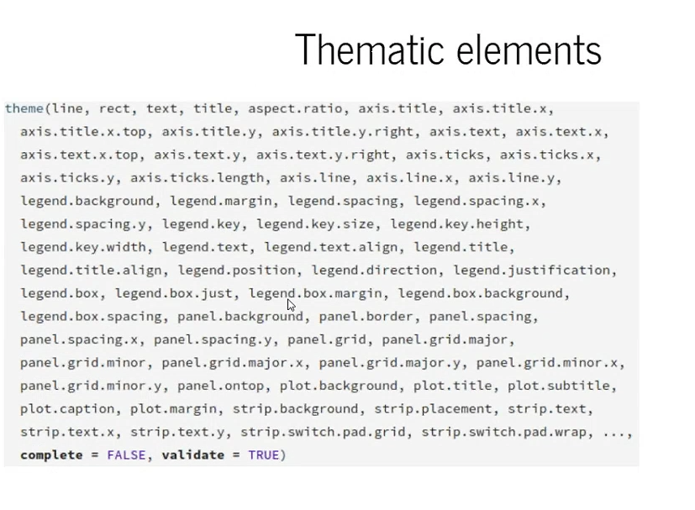
Notes:
Additional non-data elements are established by theme
Look at how many arguments theme takes

Slide 38
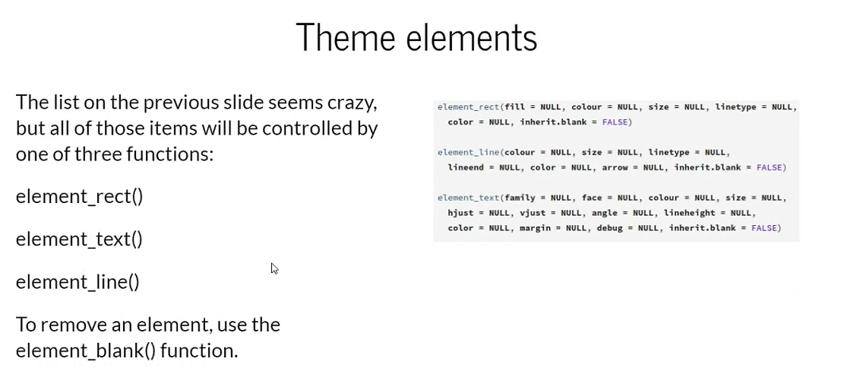
Notes:
3 categories for theme elements: rectangle, text, or line

Slide 39
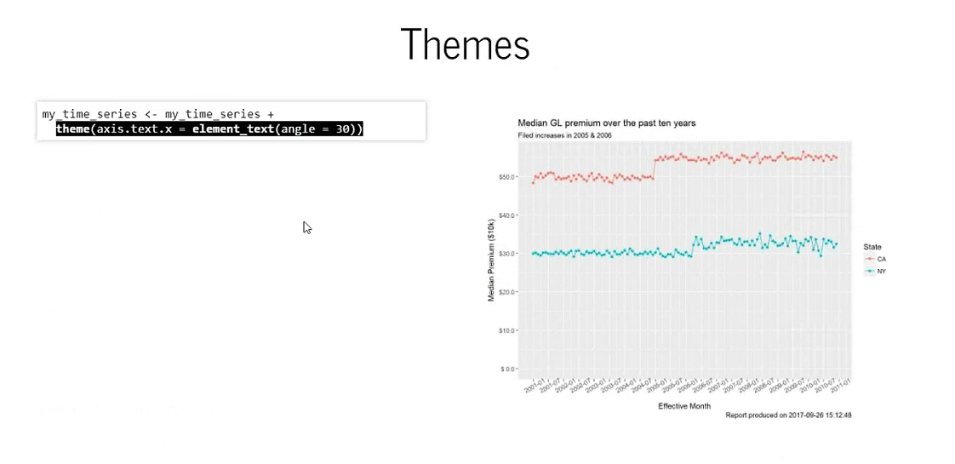
Notes:
Pass in a value for axis.text.x to stop the x-axis test from overlapping

Slide 40
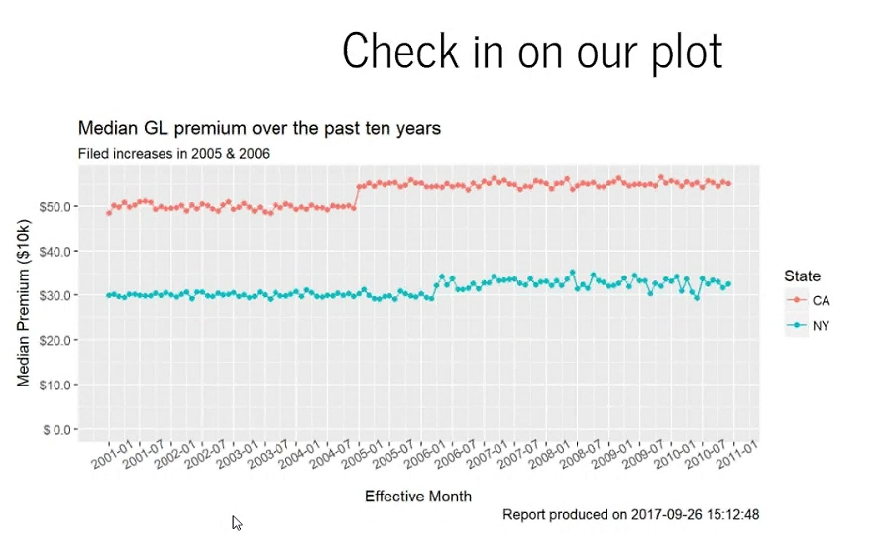
Notes:
Updated time series plot!
Took data, summarized it, created a time series split by state, we have told ggplot to draw a y-axis scaled appropriately and with nicely formatted labels
What else can we do?

Slide 41
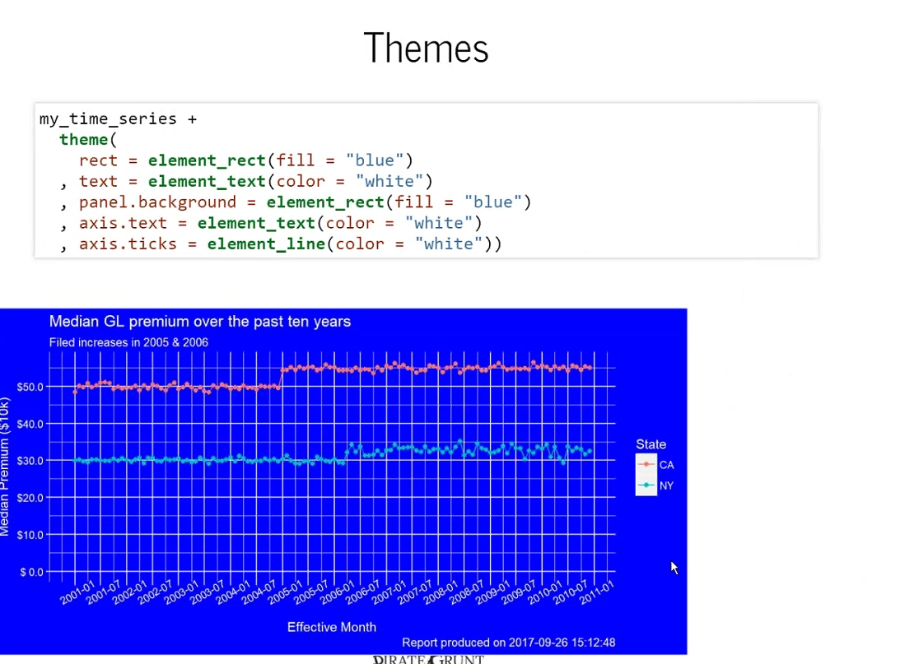
Notes:
We can use themes to change the color of the default rectangles by changing the fill color to blue, and also use white text

Slide 42
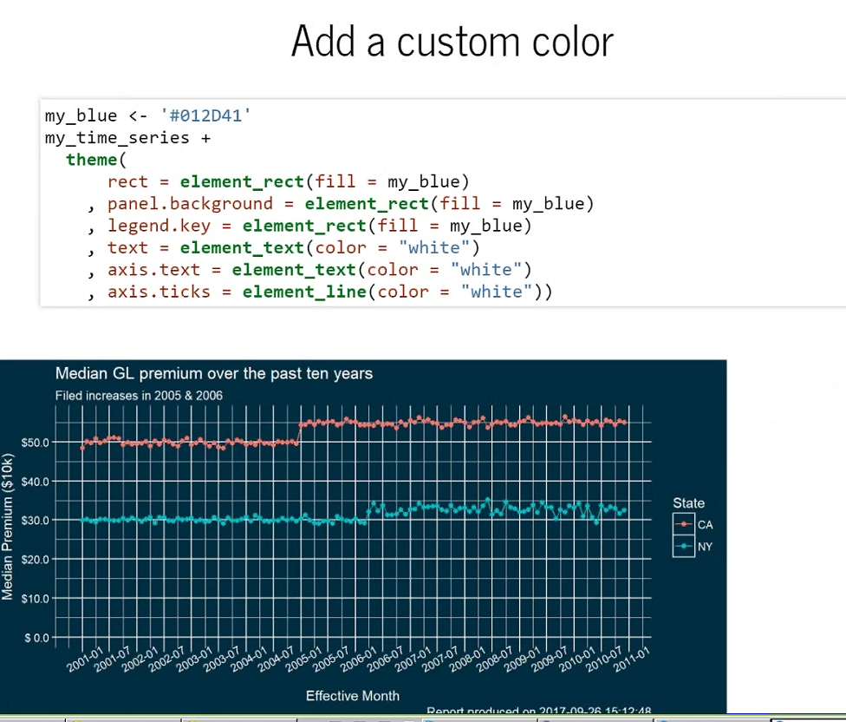
Notes:
We can add custom color!
#012D41 is a hexadecimal color (link to website in slides)

Slide 43

Notes:
We can use the scale() function to change the color and supply a manual color
We are also removing the minor gridlines with panel.grid.minor = element_blank()

Slide 44

Notes:
Final!
WHAMO!!!

Slide 45

Notes:
Check out his blog! Pirategrunt.com

Slide 46


